Slide 1

Multimedia Data Management
Lecture 3 – Entity-Relationship Model
Fall 2022

Slide 2
What is the roadmap to design a database?

Slide 3

Database Design
The task of creating a database application involves:
Designing the database schema
Designing the programs to retrieve and update data
Designing a security scheme to control access to data

Slide 4
Design Phase
Identifying the needs from the prospective of a user
Choosing a data model
Translating the requirements into a schema, by applying the concepts of that data model
Reviewing the schema to ensure it meets functional requirements

Slide 5
Design Phase
The process of moving from an abstract data model to the implementation of the database proceeds in two final design phases.
Logical Design – Deciding on the database schema. Database design requires that we find a “good” collection of relation schemas.
Business decision – What attributes should we record in the database?
Computer Science decision – What relation schemas should we have and how should the attributes be distributed among the various relation schemas?
Physical Design – Deciding on the physical layout of the database

Slide 6
Design Approaches
Entity Relationship Model – (Lecture 3)
Models an enterprise as a collection of entities and relationships
Entity: a “thing” or “object” in the enterprise that is distinguishable from other objects, described by a set of attributes
Relationship: an association among several entities
Represented by an entity-relationship diagram
Normalization Theory – (Lecture 4)
Formalize what designs are bad and how to look for them

Slide 7
ER model – Database Modeling
The ER data model was developed to facilitate database design by allowing specification of an enterprise schema that represents the overall logical structure of a database.
The ER model is very useful in mapping the meanings and interactions of real-world enterprises to a conceptual schema. As a result, many database-design tools rely on concepts from the ER model.

Slide 8
Major Issues
In designing a database schema, we must ensure that we avoid two major pitfalls:
Redundancy: A bad design may repeat information.
Example: if we store the course identifier and title of a course with each course being offered, the title would be stored redundantly. It is enough to store only the course identifier with each course, and to associate the title with the course identifier only once, in a course entity
Incompleteness: A bad design may make certain aspects of the enterprise difficult or impossible to model.
Example: if we only have entities corresponding to sections, without having an entity corresponding to courses and repeat all the course information once for each section, it would then be impossible to represent information about a new course, unless that course is offered.
Notes:
In a correct implementation we had section table and course table.

Slide 9
ER model - Database Modeling
The ER data model employs three basic concepts:
Entity sets
Relationship sets
Attributes
The ER model also has an associated diagrammatic representation, the ER diagram, which can express the overall logical structure of a database graphically.

Slide 10
Entity
An entity is an object that exists and is distinguishable from other objects.
Example: instructors, students, departments, courses
An entity set is a set of entities of the same type that share the same properties.
Example: set of all instructors, students, departments, courses

Slide 11
Attributes
An entity is represented by a set of attributes; i.e., descriptive properties possessed by all members of an entity set.
Example:
instructor = (ID, name, street, city, salary)
course = (course_id, title, credits)
A subset of the attributes form a primary key of the entity set; i.e., uniquely identifying each member of the set.

Slide 12
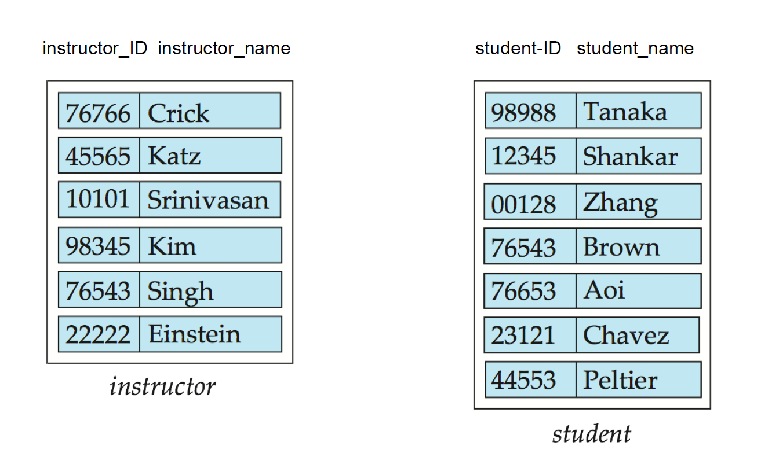
Entity Sets - instructor and student

Slide 13
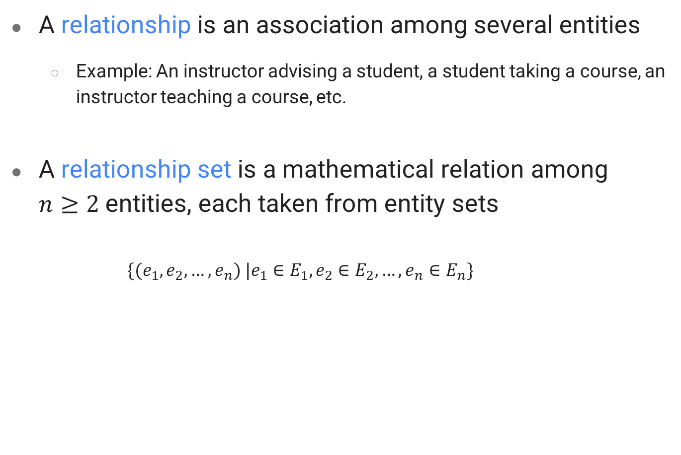
Relationship
A relationship is an association among several entities
Example: An instructor advising a student, a student taking a course, an instructor teaching a course, etc.
A relationship set is a mathematical relation among $n≥2$ entities, each taken from entity sets
$$\{(e_{1}, e_{2}, …,e_{n}) |e_{1}∈E_{1},e_{2}∈E_{2}, …,e_{n}∈E_{n}\}$$
Notes:
44553 (Peltier) student entity
22222 (Einstein) instructor entity
advisor relationship set
where (e1, e2, …, en) is a relationship
(44553,22222) $∈$ advisor

Slide 14
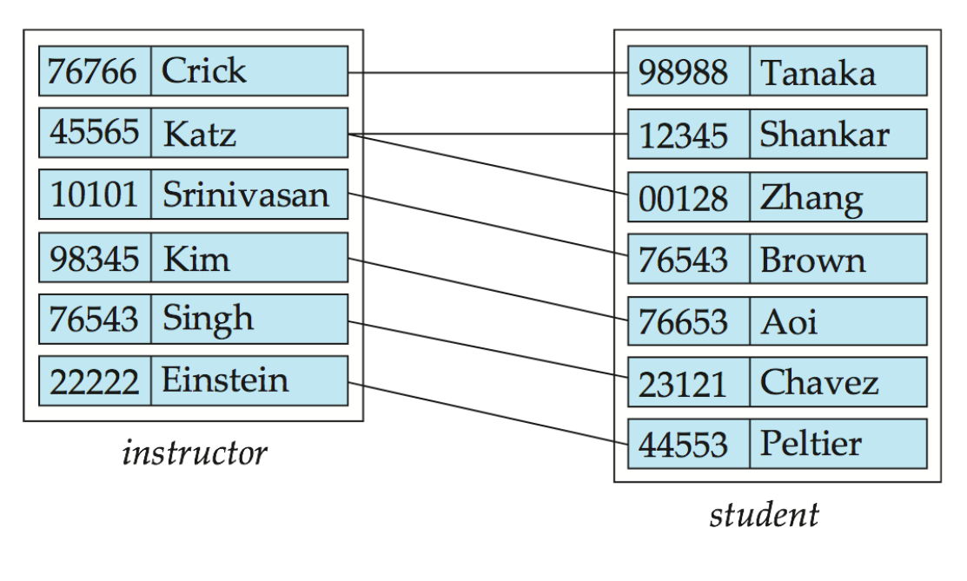
Relationship Set advisor

Slide 15
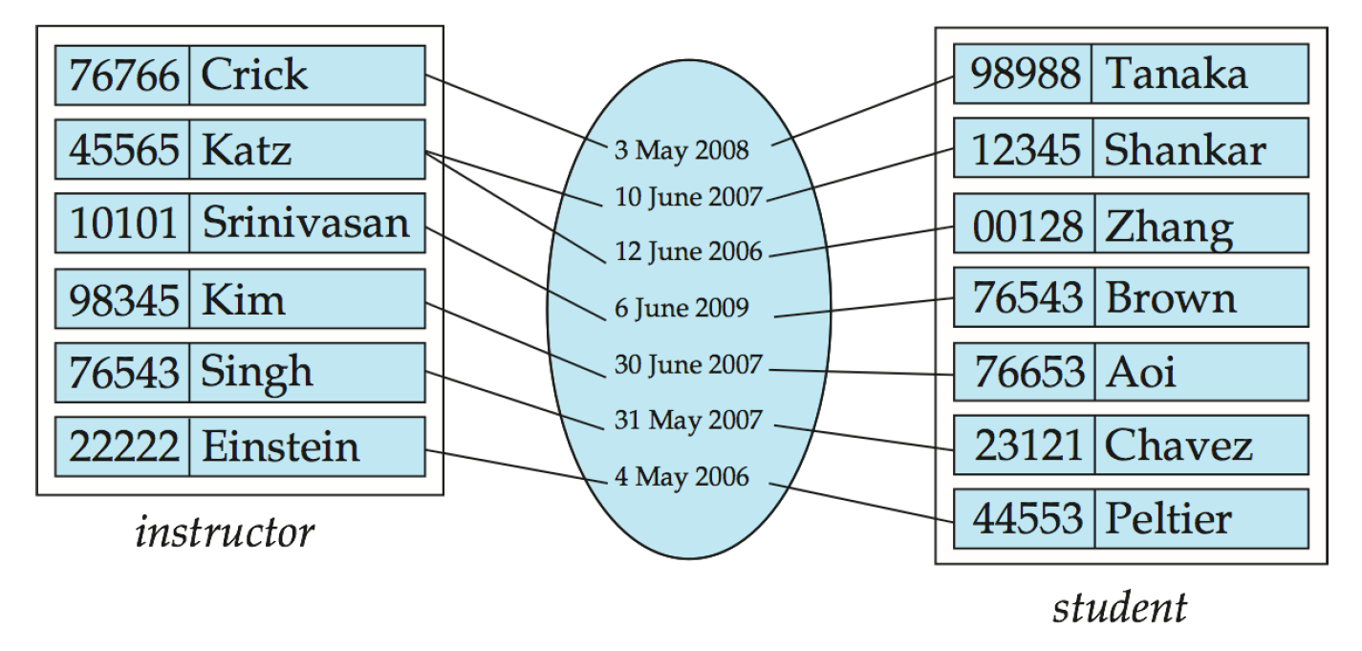
Descriptive Attributes
An attribute can also be associated with a relationship set.
Example: the advisor relationship set between entity sets instructor and student may have the attribute date that tracks the starting date of a student being assigned to the advisor.

Slide 16
Degree of a Relationship Set
Binary relationship
involves two entity sets (or degree two)
most relationship sets in a database system are binary
Example: Advisor relationship between instructor and student
Relationships involving more than two entity sets
Example: students working on research projects under the supervision of an instructor.
relationship proj_guide is a trinary relationship between instructor, student, and project
Notes:
N in our example was the degree of our relationship
Note that we have three entities not three columns

Slide 17
Mapping Cardinality Constraints
Express the number of entities to which another entity can be associated via a relationship set
Most useful in describing binary relationship sets
For a binary relationship set the mapping cardinality must be one of the following types:
One to one
One to many
Many to one
Many to many

Slide 18
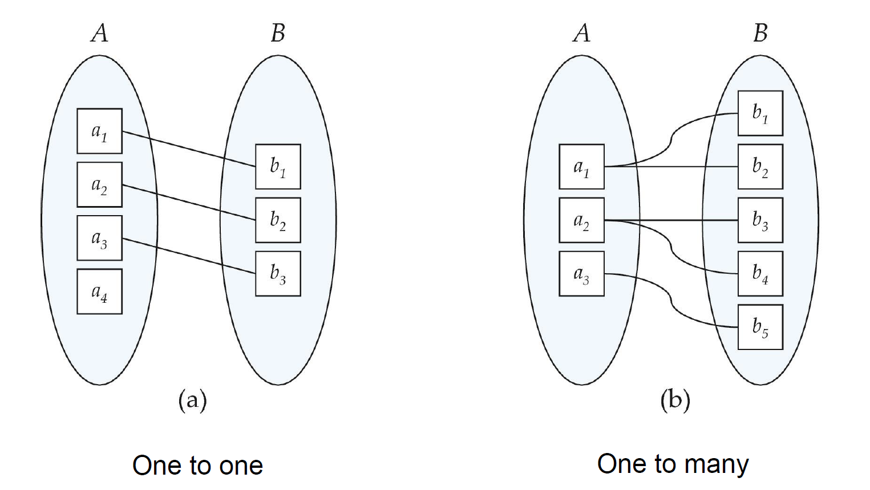
Mapping Cardinalities
Notes:
Note: Some elements in A and B may not be mapped to any elements in the other set

Slide 19
Participation
Total participation: every entity in the entity set participates in at least one relationship in the relationship set
Example: participation of student in advisor relation. (Every student must have an associated instructor)
Partial participation: some entities may not participate in any relationship in the relationship set
Example: participation of instructor in advisor. (Only some of the instructor entities are related to the student entity set through the advisor relationship)

Slide 20
Designing Attributes
Types:
Simple and composite attributes
Single-valued and multivalued attributes
Example: multivalued attribute: phone_numbers
Derived attributes
Can be computed by having some other attributes
Example: age, given date_of_birth
Domain – the set of permitted values for each attribute
Notes:
Why should we store derived attributes?
There is a trade off between computation and storage -> speed of our database

Slide 21
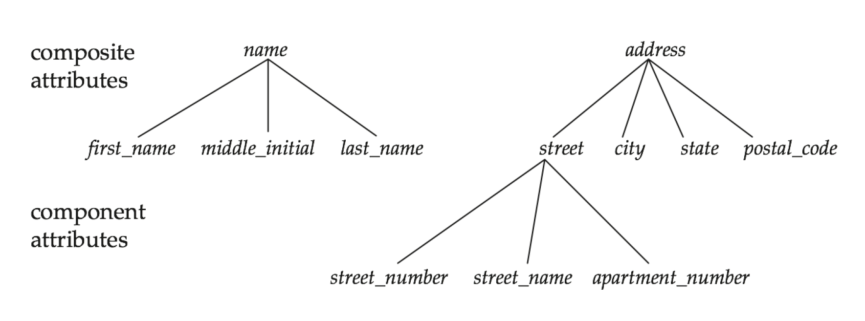
Composite Attributes

Slide 22
Designing Attributes
Once the entity sets are decided upon, we must choose the appropriate attributes.
These attributes are supposed to represent the various values we want to capture in the database.
The decision of what attributes to include is up to the designer, who has a good understanding of the structure of the enterprise.
Example: for the instructor entity set,
we included ID, name, dept_name, and salary
We can also add phone_number, office_number, homepage, etc.

Slide 23
Redundant Attributes
Suppose we have entity sets instructor and department
We should implement the fact that each instructor has an associated department in our model
Two possible approaches:
Using the attribute dept_name appears in instructor
instructor: ID, name, dept_name, salary
department: dept_name, building, budget
Using a relationship set inst_dept
instructor: ID, name, salary
department: dept_name, building, budget
inst_dept: ID, dept_name
Notes:
the attribute dept_name in instructor is redundant and should be removed

Slide 24
Section Scenario
Suppose we want to model the fact that each course is offered within one or more sections
Two possible approaches:
Using the attribute course_id appears in section
Using the relationship set sec_course between entity sets section and course
course_id is redundant information appeared in section, since sec_course already has an attribute course_id, which identifies the course with which the section is related.
One option to deal with this redundancy is to not store the attribute course_id in the section entity and to only store the remaining attributes section_id, year, and semester. However, the entity set section then does not have enough attributes to identify a particular section entity uniquely; different courses may share the same section_id, year, and semester.

Slide 25
Weak Entity Sets
A weak entity set is one whose existence is dependent on another entity, called its identifying entity
Example:
Weak entity: section
Identifying entity: course
Instead of associating a primary key with a weak entity, we use the identifying entity, along with extra attributes called discriminator to uniquely identify a weak entity.
An entity set that is not a weak entity set is termed a strong entity set.

Slide 26
Weak Entity Sets
Every weak entity must be associated with an identifying entity
The weak entity set is said to be existence dependent on the identifying entity set.
The identifying entity set is said to own the weak entity set that it identifies.
The relationship associating the weak entity set with the identifying entity set is called the identifying relationship.

Slide 27
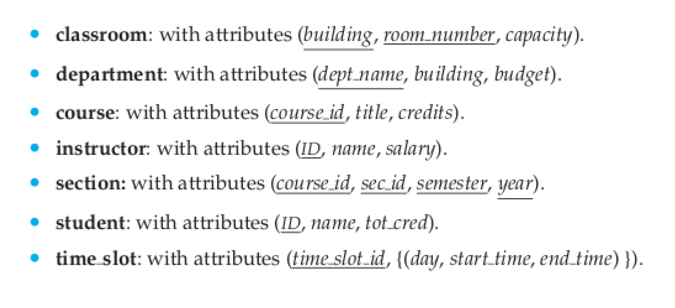
Recap
List of of entity sets and their attributes

Slide 28
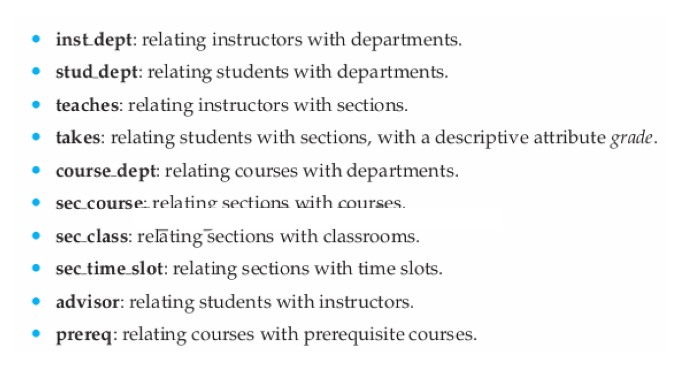
Recap
List of of relationships

Slide 29
How to represent our E-R model?

Slide 30
Entity Sets
Entities can be represented graphically as follows:
Rectangles represent entity sets
Attributes listed inside entity rectangle
Underline indicates primary key attributes

Slide 31
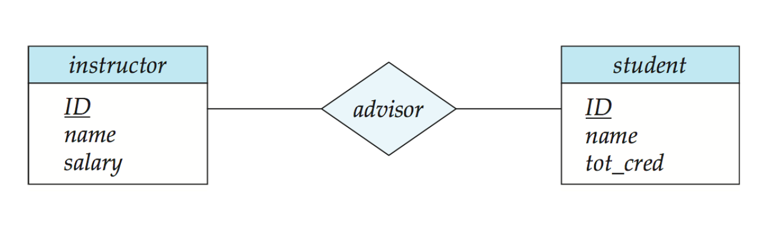
Relationship Sets
Diamonds represent relationship sets

Slide 32
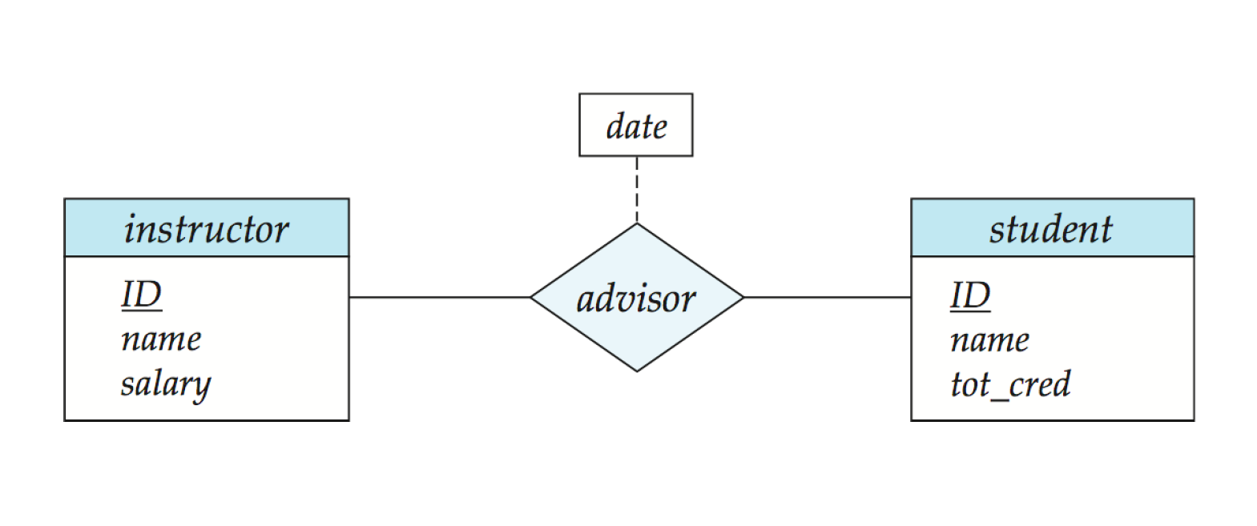
Relationship Sets - Attributes
Diamonds represent relationship sets
Connect attributes list with a dashed line

Slide 33
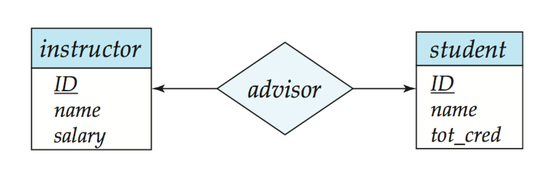
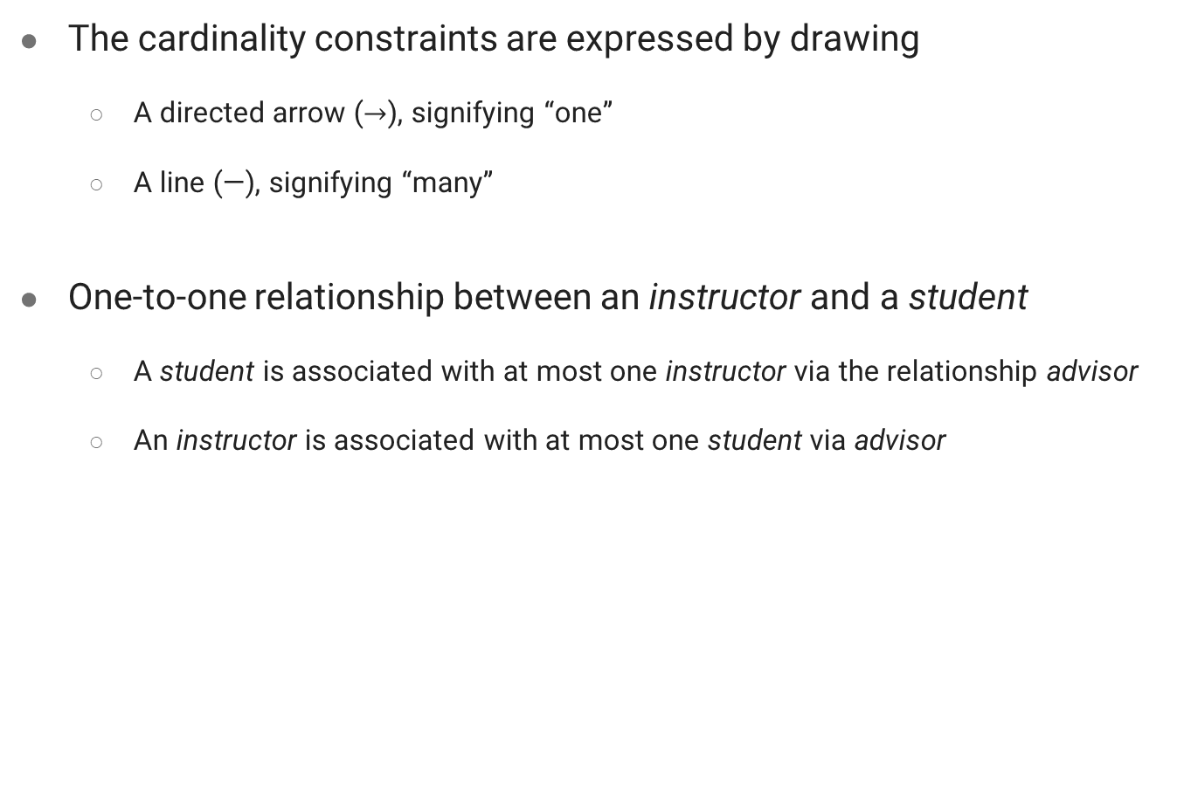
Cardinality Constraints
The cardinality constraints are expressed by drawing
A directed arrow ($→$), signifying “one”
A line (—), signifying “many”
One-to-one relationship between an instructor and a student
A student is associated with at most one instructor via the relationship advisor
An instructor is associated with at most one student via advisor
Notes:
Let’s assume it’s one to one

Slide 34
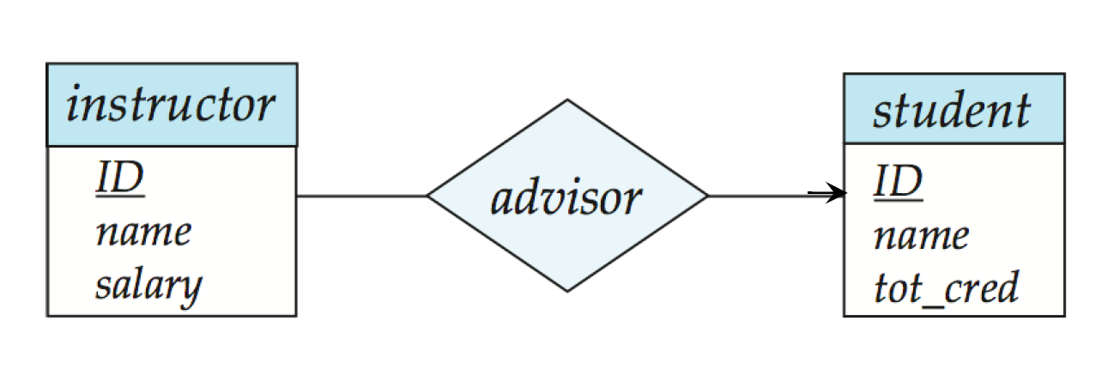
Cardinality Constraints
Many-to-one relationship between an instructor and a student
An instructor is associated with at most one student via advisor
A student is associated with several (including 0) instructors via advisor
Notes:
Let’s assume it’s many to one

Slide 35
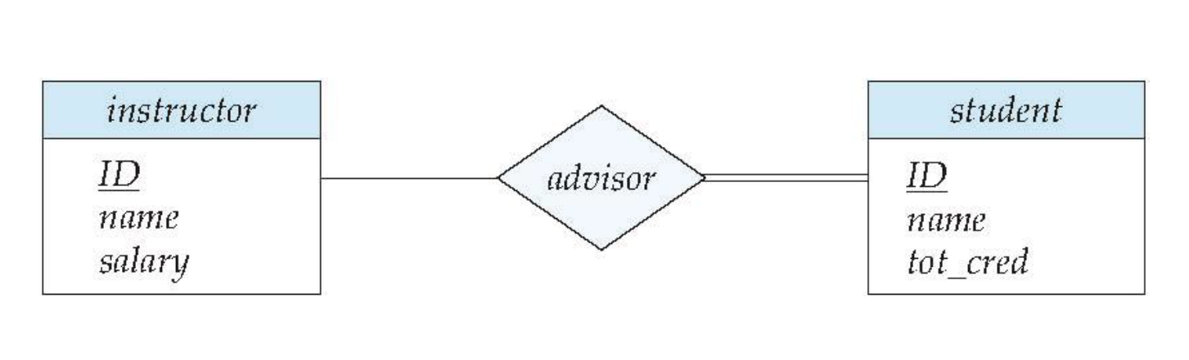
Total vs. Partial Participation
Total participation (indicated by double line): every element in the entity set participates in at least one relationship in the relationship set
Every student must have an associated instructor
Partial participation: some elements in the entity set may not participate in any relationships in the relationship set
Participation of instructor in advisor is partial

Slide 36
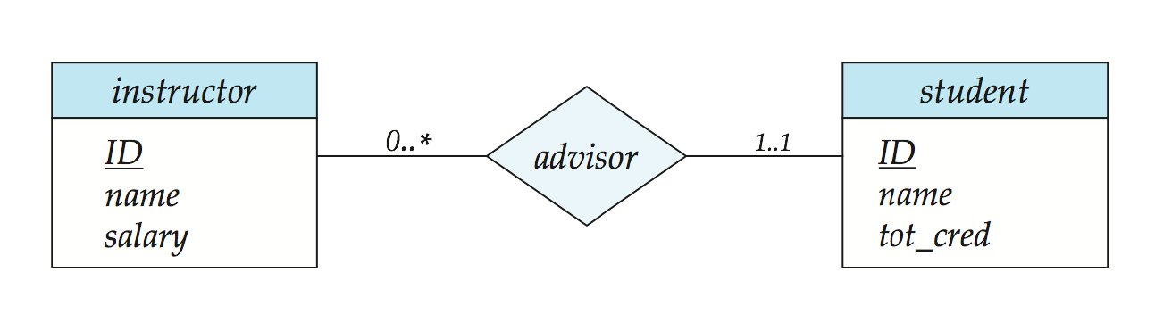
Complex Constraints
A line may have an associated minimum and maximum cardinality, shown in the form l..h, where l is the minimum and h the maximum cardinality
A minimum value of 1 indicates total participation
A maximum value of 1 indicates that the entity participates in at most one relationship
A maximum value of * indicates no limits
Notes:
Instructor can advise 0 or more students. A student must have 1 advisor; cannot have multiple advisors

Slide 37
Complex Attributes
Multi-valued attributes are represented via { }
Derived attributes come with ()

Slide 38
Weak Entity Sets
A weak entity set is depicted via a double rectangle
The discriminator of a weak entity set is underlined with a dashed line
The relationship set connecting the weak entity set to the identifying strong entity set is depicted by a double diamond
Primary key for section – (course_id, sec_id, semester, year)

Slide 39
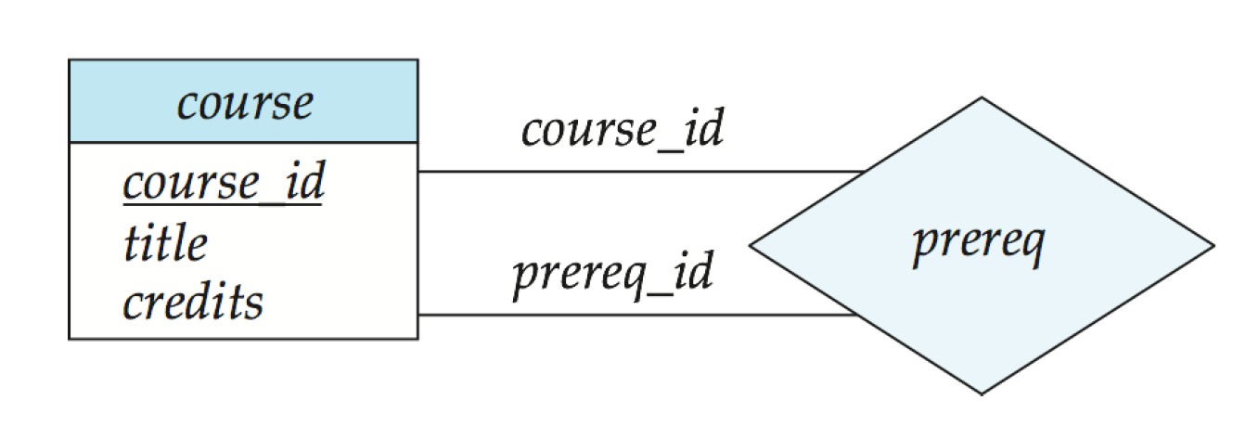
Roles
Entity sets of a relationship are not necessarily distinct
Each occurrence of an entity set plays a “role” in the relationship
The labels “course_id” and “prereq_id” are called roles

Slide 40
Trinary Relationship Sets
Three entity sets instructor, student, and project, related through the relationship set proj_guide.
Notes:
What if we draw arrows in a trinary relationship?
NOTE: arrows can be interpreted in different ways.
We allow at most one arrow out of a ternary (or greater degree) relationship to indicate a cardinality constraint
For example, an arrow from proj_guide to instructor indicates each student has at most one guide for a project
If there is more than one arrow, there are two ways of defining the meaning.
For example, a ternary relationship R between A, B and C with arrows to B and C could mean
1. Each A entity is associated with a unique entity from B and C or
2. Each pair of entities from (A, B) is associated with a unique C entity, and each pair (A, C) is associated with a unique B
To avoid confusion we outlaw more than one arrow

Slide 41
E-R Diagram for a University Enterprise

Slide 42
Reduction to Relation Schemas
Entity sets and relationship sets can be expressed uniformly as relation schemas that represent the contents of the database
A database which conforms to an E-R diagram can be represented by a collection of relation schemas
For each entity set and relationship set there is a unique relation schema that is assigned the name of the corresponding entity set or relationship set
Each schema has a number of columns (generally corresponding to attributes), which have unique names

Slide 43
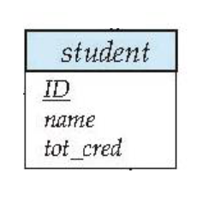
Representing Entity Sets
A strong entity set reduces to a relation schema with the same attributes
student(ID, name, tot_cred)

Slide 44
Representing Entity Sets

Slide 45
Representing Weak Entity Sets
A weak entity set becomes a table that includes a column for the primary key of the identifying strong entity set
section ( course_id, sec_id, sem, year)

Slide 46
Representing Composite Attributes
Composite attributes are flattened out by creating a separate attribute for each component attribute
Example: given entity set instructor with composite attribute name with component attributes first_name and last_name the schema corresponding to the entity set has two attributes name_first_name and name_last_name
Prefix omitted if there is no ambiguity (name_first_name could be first_name)
Ignoring multivalued attributes, extended instructor schema is
instructor(ID, first_name, middle_initial, last_name, street_number, street_name, apt_number, city, state, zip_code, date_of_birth)

Slide 47
Representing Multivalued Attributes
A multivalued attribute M of an entity E is represented by a separate schema EM
Schema EM has attributes corresponding to the primary key of E and an attribute corresponding to multivalued attribute M
Example: Multivalued attribute phone_number of instructor is represented by a schema:
inst_phone= ( ID, phone_number)
Each value of the multivalued attribute maps to a separate tuple of the relation on schema EM
For example, an instructor entity with primary key 22222 and phone numbers 456-7890 and 123-4567 maps to two tuples: (22222, 456-7890) and (22222, 123-4567)

Slide 48
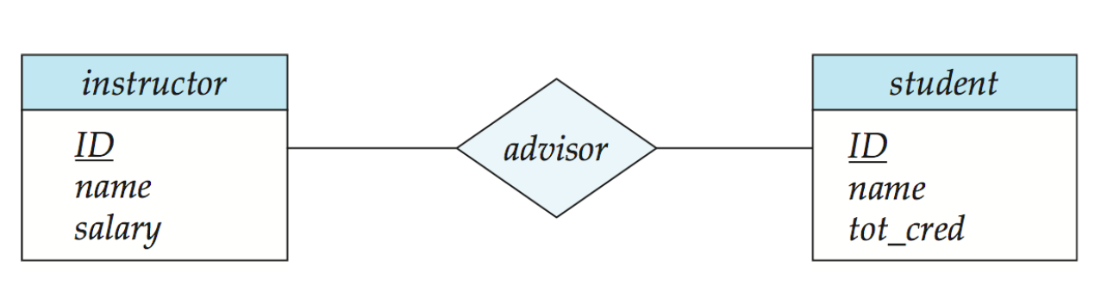
Representing Relationship Sets
A binary many-to-many relationship set is represented as a schema with attributes for the primary keys of the two participating entity sets, and any descriptive attributes of the relationship set
Example: schema for relationship set advisor
advisor = (s_id, i_id)

Slide 49
Representing Relationship Sets
For a binary one-to-one relationship set, the primary key of either entity set can be chosen as the primary key. The choice can be made arbitrarily
For a binary many-to-one or one-to-many relationship set, the primary key of the entity set on the “many” side of the relationship set serves as the primary key
For a non-binary relationship set without any arrows on its edges, the union of the primary key-attributes from the participating entity sets becomes the primary key
For a non-binary relationship set with an arrow on one of its edges, the primary keys of the rest of the entity sets are included in the union to serve as the primary key for the schema. Recall that there is at most one arrow allowed.

Slide 50
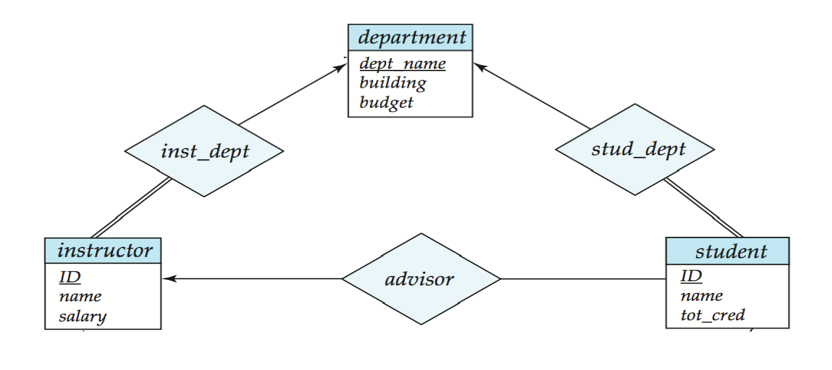
Redundancy of Schemas
Many-to-one and one-to-many relationship sets that are total on the many-side can be represented by adding an extra attribute to the “many” side, containing the primary key of the “one” side
Example: Instead of creating a schema for relationship set inst_dept or stud_dept, add an attribute dept_name to the schema arising from entity set instructor or student

Slide 51
Redundancy of Schemas
For one-to-one relationship sets, either side can be chosen to act as the “many” side
i.e., an extra attribute can be added to either of the tables corresponding to the two entity sets
If participation is partial on the “many” side, replacing a schema by an extra attribute in the schema corresponding to the “many” side could result in null values

Slide 52
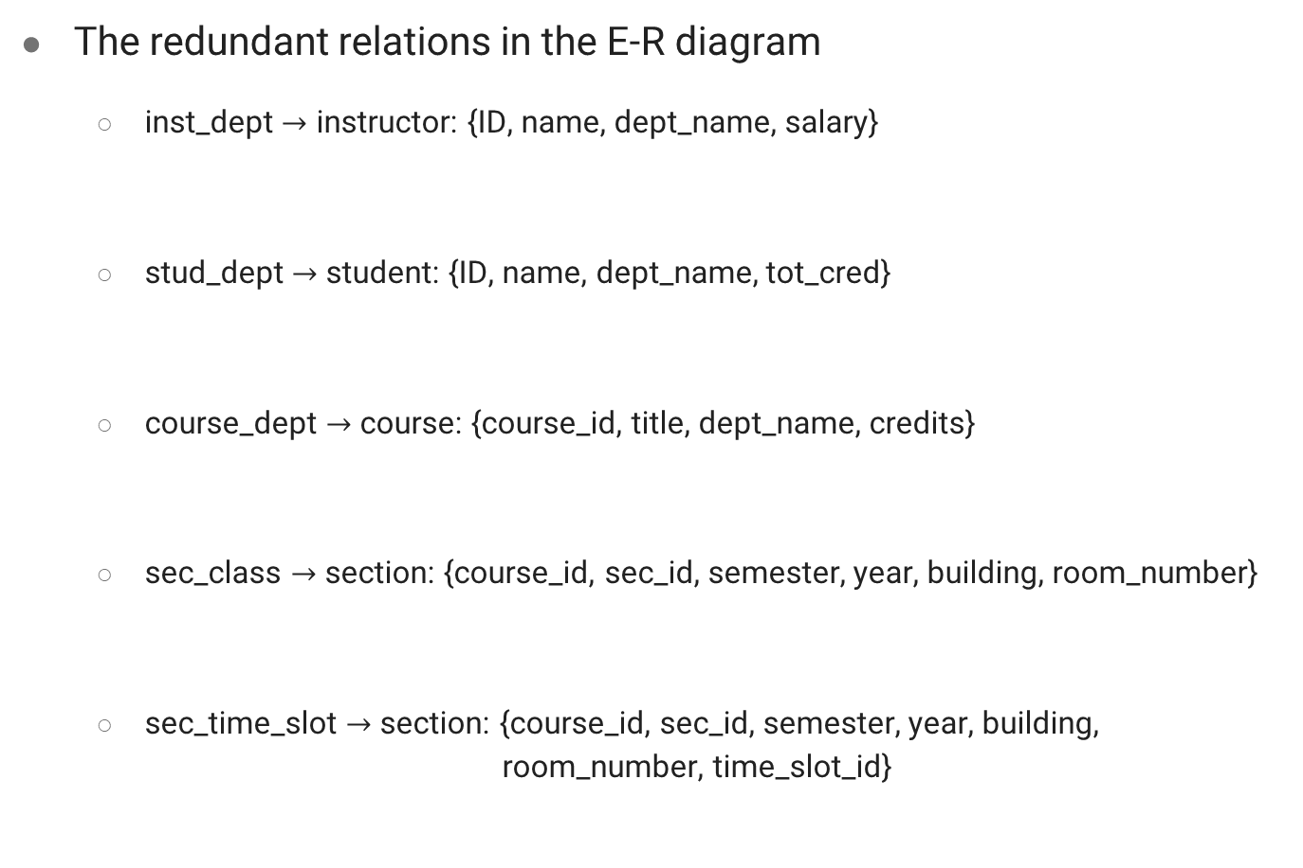
Redundancy of Schemas
The redundant relations in the E-R diagram
inst_dept $→$ instructor: {ID, name, dept_name, salary}
stud_dept $→$ student: {ID, name, dept_name, tot_cred}
course_dept $→$ course: {course_id, title, dept_name, credits}
sec_class $→$ section: {course_id, sec_id, semester, year, building, room_number}
sec_time_slot $→$ section: {course_id, sec_id, semester, year, building, room_number, time_slot_id}

Slide 53
Redundancy of Schemas
The schema corresponding to a relationship set linking a weak entity set to its identifying strong entity set is redundant
Example: The section schema already contains the attributes that would appear in the sec_course schema

Slide 54
Extended E-R Features

Slide 55
Specialization
An entity set may include subgroupings of entities that are distinct from other entities in the set (e.g., some attributes that are not shared by all the entities in the entity set)
These sub-groupings become lower-level entity sets that have attributes or participate in relationships that do not apply to the higher-level entity set
The process of designating subgroupings within an entity set is called specialization
Depicted by a triangle component labeled ISA (e.g., instructor “is a” person)
Attribute inheritance – a lower-level entity set inherits all the attributes and relationship participation of the higher-level entity set to which it is linked.
Higher- and lower-level entity sets also may be designated by the terms superclass and subclass,

Slide 56
Specialization
the entity set person may be further classified as:
employee
student

Slide 57
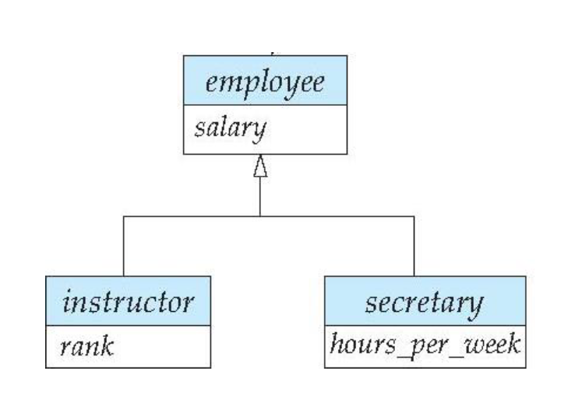
Specialization
university employees may be further classified as:
instructor
secretary

Slide 58
Specialization example
Overlapping
An entity may belong to multiple specialized entity sets
Example: employee and student
Disjoint
Entities must belong to at most one specialized entity set
instructor and secretary
Notes:
How can we implement that?

Slide 59
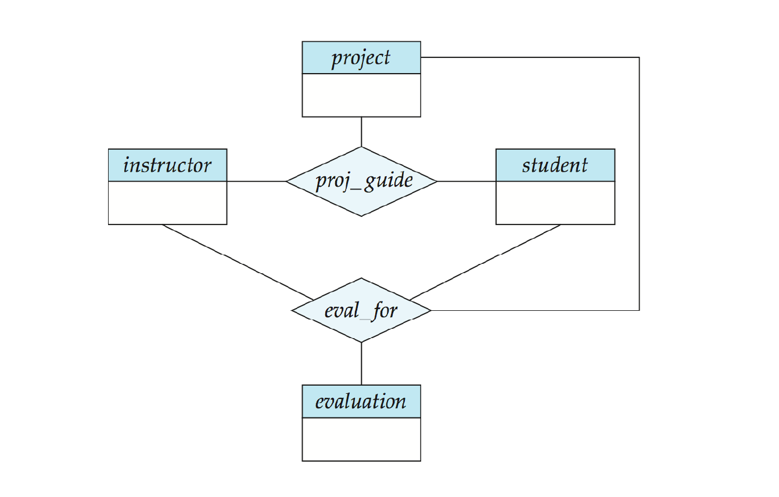
Aggregation
Consider the trinary relationship proj_guide, which we saw earlier
Suppose we want to record monthly evaluation reports of a student by a guide on a project

Slide 60
Aggregation
Relationship sets eval_for and proj_guide share overlapping information
Every eval_for relationship corresponds to a proj_guide relationship
However, some proj_guide relationships may not correspond to any eval_for relationships
So, we can’t discard the proj_guide relationship
Eliminate this redundancy via aggregation
Treat a relationship as an abstract entity
Allows relationships between relationships
Abstraction of relationship into new entity

Slide 61
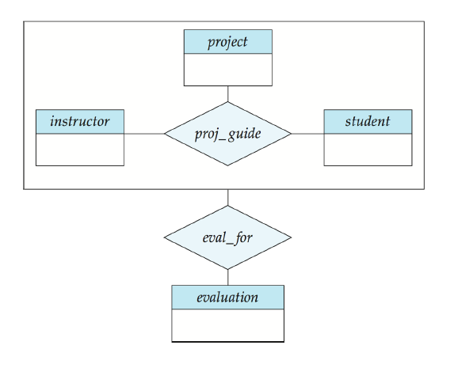
Aggregation
Eliminate this redundancy via aggregation without introducing redundancy, the following diagram represents
A student is guided by a particular instructor on a particular project
A student, instructor, project combination may have an associated evaluation

Slide 62
Representing Aggregation via Schemas
To represent aggregation, create a schema containing
Primary key of the aggregated relationship
(No separate relation is required to represent the aggregation; the relation created from the defining relationship is used instead.)
The primary key of the associated entity set
Any descriptive attributes
In our example:
The schema evaluation is:
evaluation (evaluation_id, report)
The schema eval_for is:
eval_for (s_ID, project_id, i_ID, evaluation_id)

Slide 63
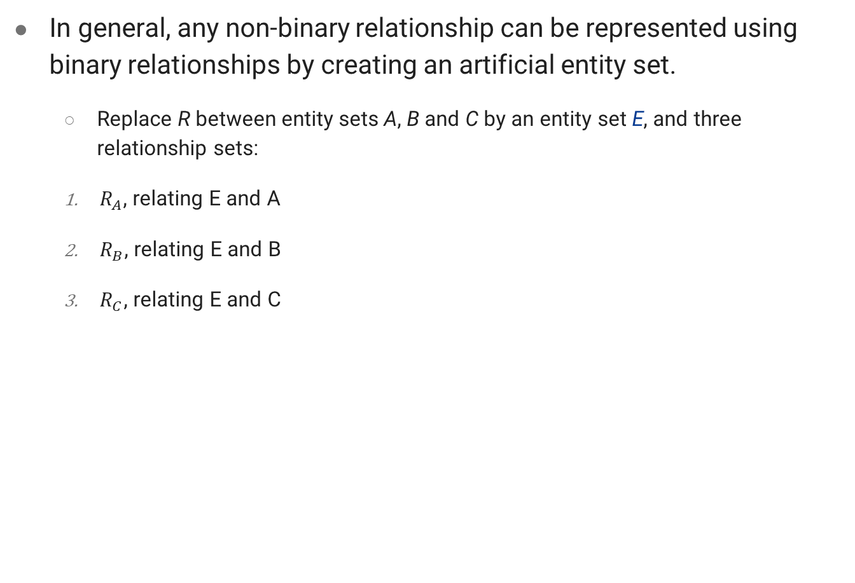
Converting Relationships to Binary Form
In general, any non-binary relationship can be represented using binary relationships by creating an artificial entity set.
Replace R between entity sets A, B and C by an entity set E, and three relationship sets:
$R_{A}$, relating E and A
$R_{B}$, relating E and B
$R_{C}$, relating E and C

Slide 64
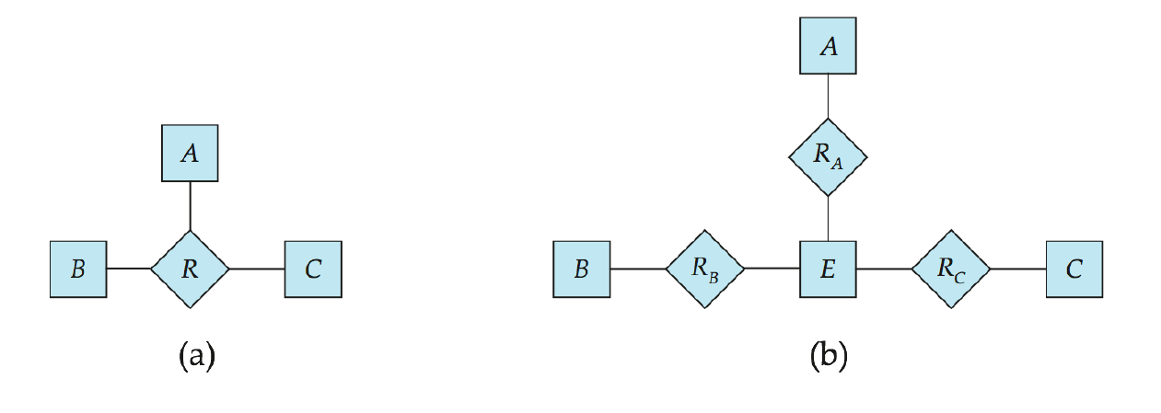

Converting Relationships to Binary Form
Create an identifying attribute for E and add any attributes of R to E
For each relationship ($a_{i}$ , $b_{i}$ , $c_{i}$) in R, create
a new entity $e_{i}$ in the entity set E
add ($e_{i}$ , $a_{i}$) to $R_{A}$
add ($e_{i}$ , $b_{i}$) to $R_{B}$
add ($e_{i}$ , $c_{i}$) to $R_{C}$

Slide 65
References
Database System Concepts - 6th edition (db-book.com)

